Slide 1
Understanding of
Action Recognition
Present by : NTNU AIoT Lab. Chou.
Reference : https://github.com/jinwchoi/awesome-action-recognition

Slide 2
Outline
Part1. action recognition research
section 1. overview
section 2. papers understanding
Part2. datasets introduction
section 1. overview
section 2. compare different datasets

Slide 3
Part1.
Action Recognition Research

Slide 4
Part1.
Action Recognition Research
Section1.
Overview of Action Recognition

Slide 5
overview
Human Action Recognition and Prediction: A Survey
Yu Kong, Yun Fu , 2018
&
Related papers

Slide 6
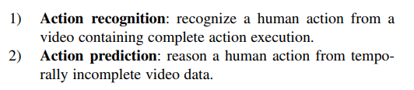
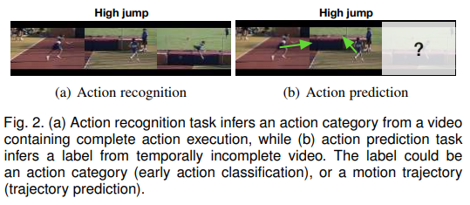
Two Topic
Overview::Paper

Slide 7
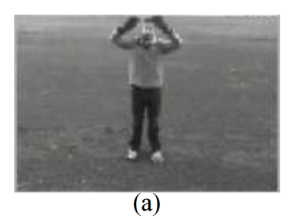
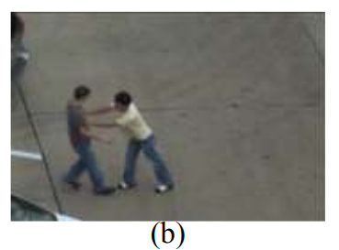
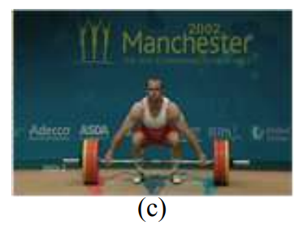
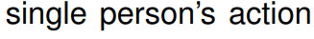
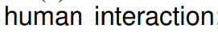
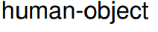
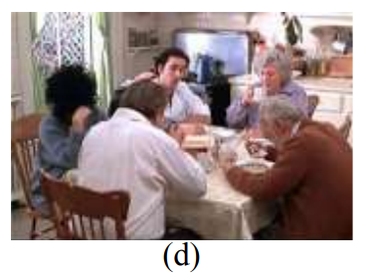
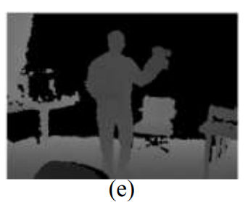
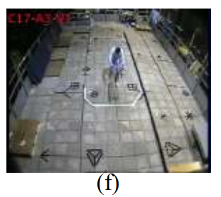
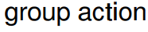
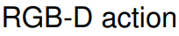
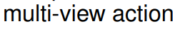
Type

Slide 8
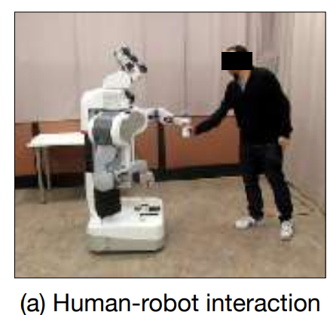
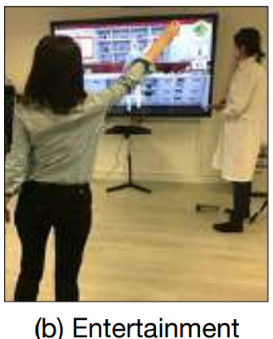
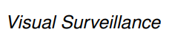
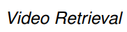
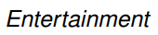
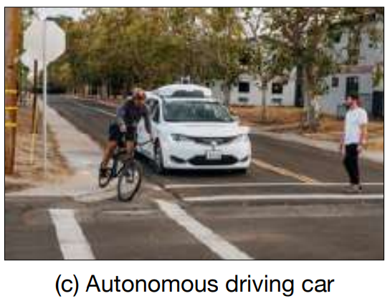
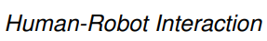
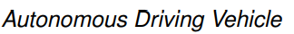
Overview::Paper
Real-World Applications
example
1.
2.
3.
4.
5.

Slide 9
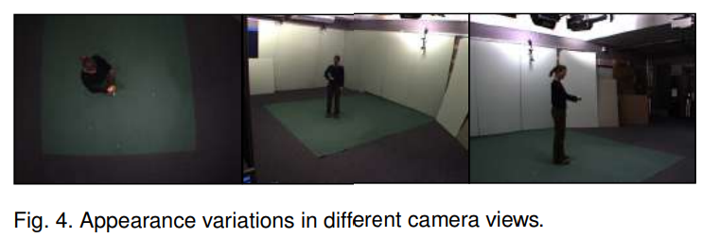
Overview::Paper
Research Challenges
1. Intra- and inter-class Variations
1-1. human behave differently for the same actions.
1-2. same action can be captured from various viewpoints.

Slide 10
Overview::Paper
Research Challenges
2. Cluttered Background and Camera Motion
2-1. background noise effect.
3. Insufficient Annotated Data
3-1. some datasets may not be 100% accurate.
3-2. difficult to label.

Slide 11
Overview::Paper
Human perception of actions
1. There are a number of information we can tell from human actions:
Action categories
Emotional implication
Identity
Gender
etc.
2. Action understanding can be decomposed into three major components:
action recognition
intention understanding
narrative understanding

Slide 12
Overview::Paper
Human perception of actions
3. Actions can be approached with a set of interrelated questions:
Who
What
Why
How
Where
When
Our topic

Slide 13
Overview::Paper
Action Recognition
Understanding

Slide 14
Overview::Paper
Some Methods of Action Recognition
A typical action recognition flowchart
deep networks
action representation
action
classification
deep learning model
input
output
input
output

Slide 15
Overview::Paper
Some Methods of Action Recognition
1. Short-term
Use Optical Flow
Use Space-Time Interest Points
or Other Points
2. Long-term
Use feature trajectory to capture
features of long-duration information
A typical action recognition flowchart
action representation
action
classification
input
output

Slide 16
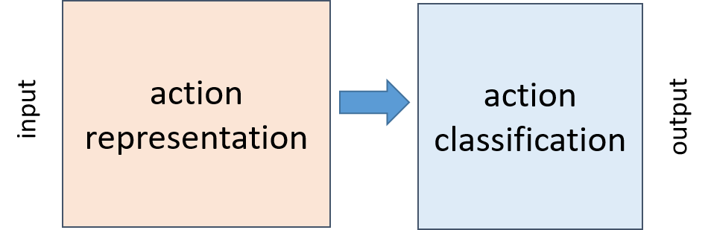
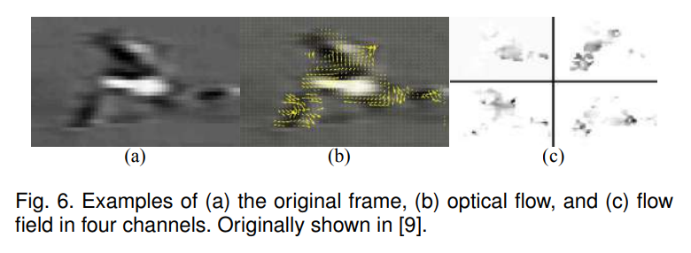

Overview::Paper
typical action recognition
- action representation : short temporal duration
1. Use Optical Flow

Slide 17
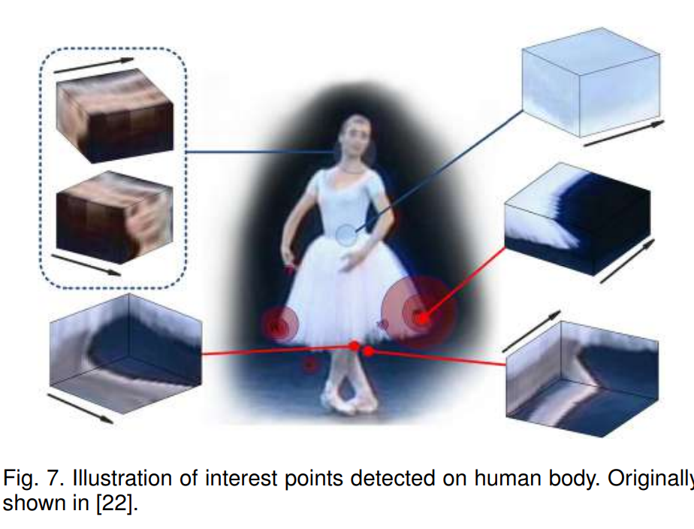

Overview::Paper
typical action recognition
- action representation : short temporal duration
2. Use Space-Time Interest Points or Other Points
SIFT
HOG
local trinary patterns

Slide 18
Overview::Paper
typical action recognition
- action representation : short temporal duration
Extract features
(some points or vectors)
Dimensionality reduction:
k-means (to make code book)
Reference:
Wiki
ITCT’s pdf

Slide 19
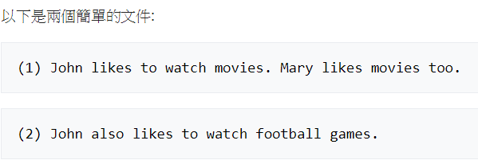
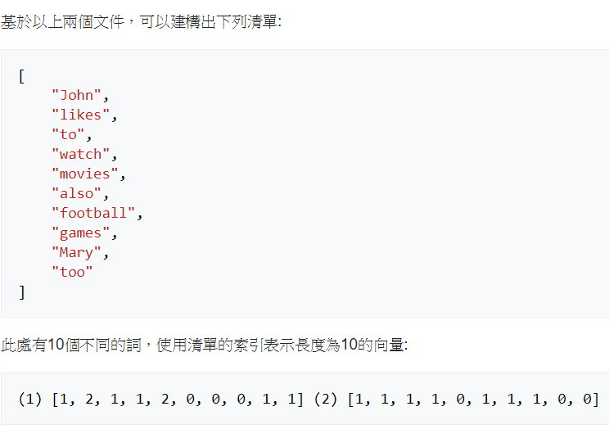
Overview::Paper
Bag of words and Word to Vector
Reference: https://zh.wikipedia.org/wiki/%E8%AF%8D%E8%A2%8B%E6%A8%A1%E5%9E%8B

Slide 20
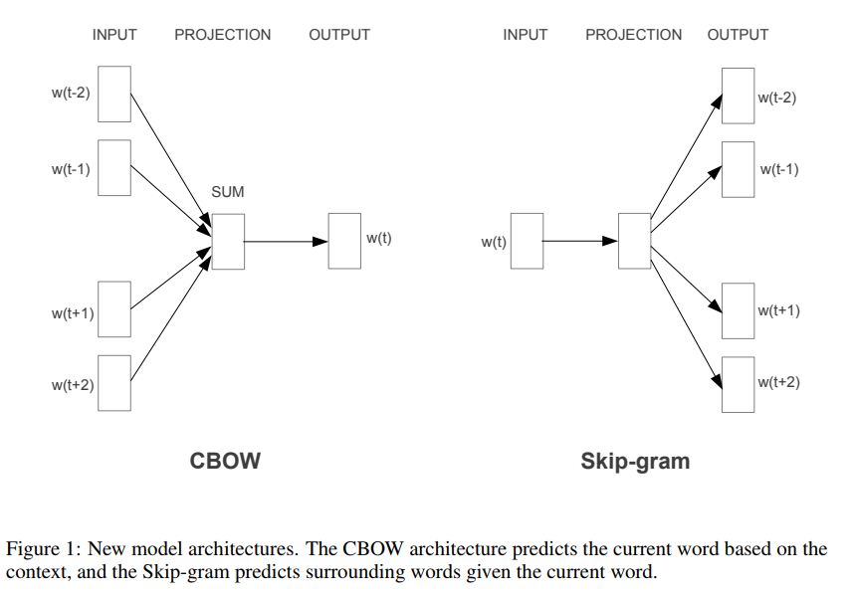
Overview::Paper
Bag of words and Word to Vector
Recommend toolkits: NLTK
1. Base on BROW(Continuous Bag-of-Words) and Skip-gram

Slide 21
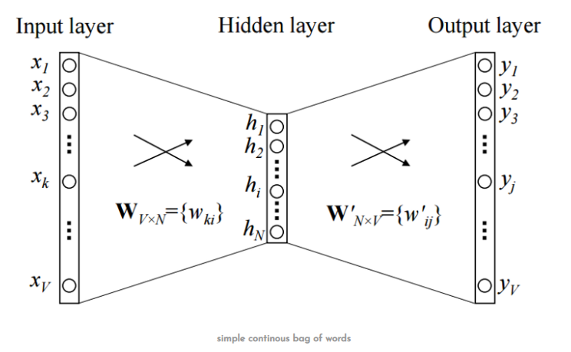
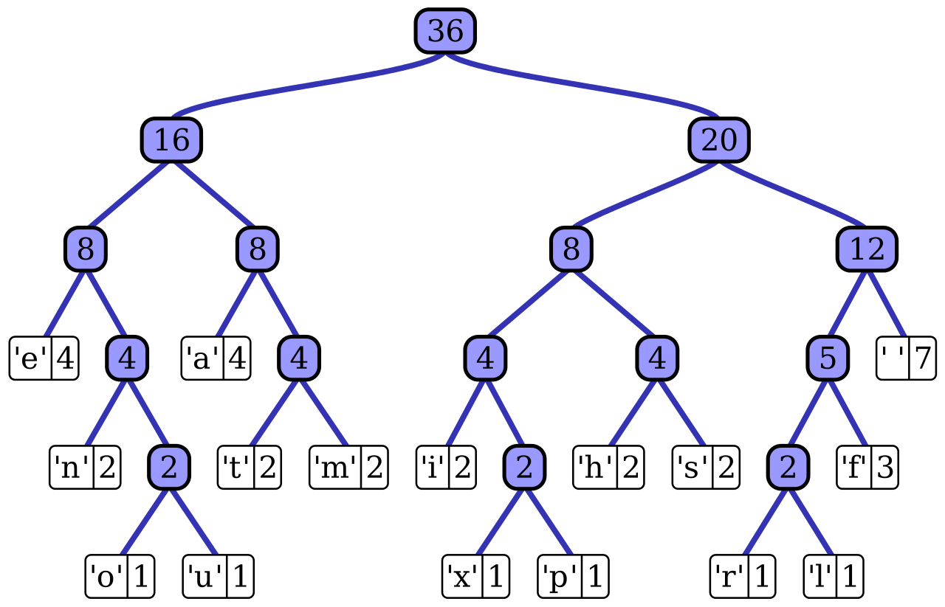
Overview::Paper
Bag of words and Word to Vector
Recommend toolkits: NLTK
Notes:
https://zhuanlan.zhihu.com/p/30001059

Slide 22
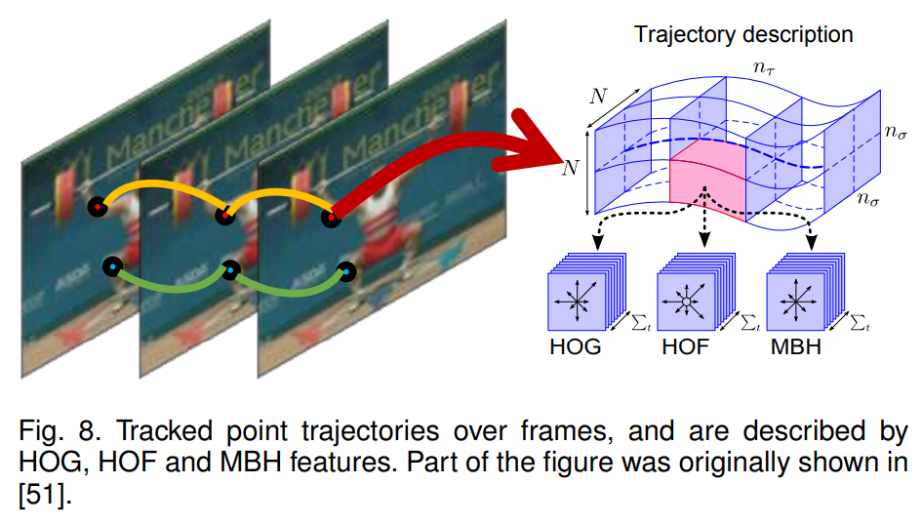

Overview::Paper
typical action recognition
- action representation : long-term duration
3. Use feature trajectory to capture features of long-duration information.
(Dense Trajectories)
* First, trajectory method:
1. KLT tracker(link).
2. described by a
concatenation of
HOG, HOF and MBH
features.

Slide 23
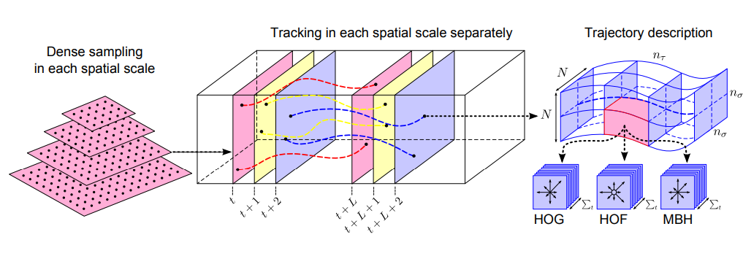
Overview::Paper
DT to IDT(Improved Dense Trajectories)
- Heng Wang et al., ICCV2013
Use bag of features to encode
SVM
DT(Dense Trajectories) structure

Slide 24
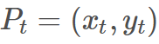
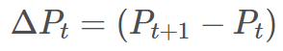
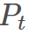
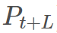
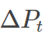
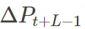
Overview::Paper
DT
 |  | ……
L=15

Slide 25
Overview::Paper
DT
1. KLT trajectories
Use HOG, HOF and MBH as descriptors.
SIFT trajectories are very robust to short boundaries.
2. SIFT trajectories
Set contrast threshold for the SIFT detector to 0.004.
SIFT trajectories are very robust to short boundaries.

Slide 26
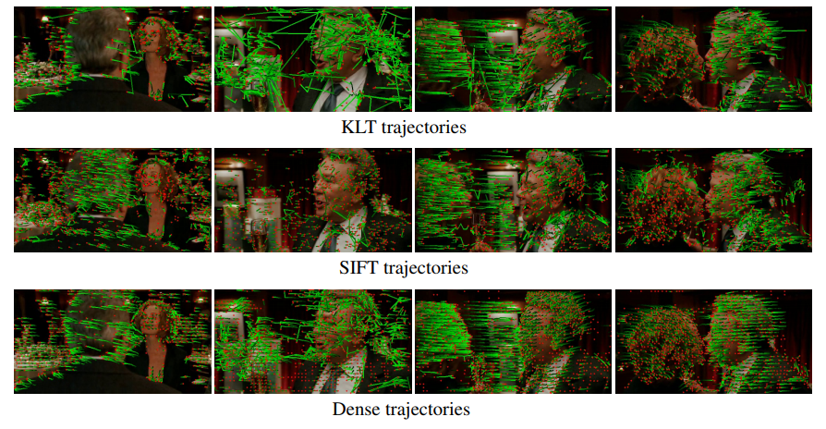
DT::Compare with trajectories
Overview::Paper

Slide 27
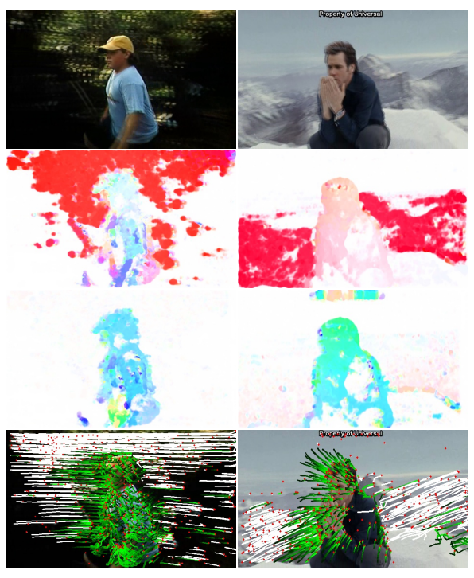
IDT
Overview::Paper
First row: images of two consecutive frames overlaid
second row: optical flow between the two frames
third row: optical flow after removing camera motion
last row: trajectories removed due to camera motion in white

Slide 28
IDT -How to Improved::Replace Spatial Flow
Overview::Paper
Removing inconsistent matches due to humans
Use Human Detecter
(link)
Optical flow
SURF flow
RANSAC
Camera motion estimation

Slide 29
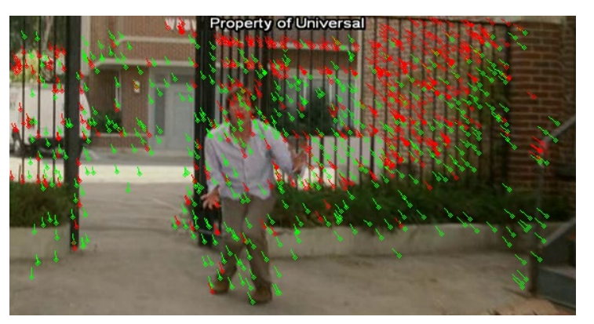
IDT
Overview::Paper
Red: dense optical flow
Green: correspond to SURF descriptor matches

Slide 30
IDT -How to Improved::Use Fisher Vector
(replace bag of features encode)
Overview::Paper
Choose K for GMM
(k = 256 in IDT case)
Fisher Vector:
base on GMM
Use Partial differential to define vector(3 kinds)
Use entire datasets to Get GMM
Use this GMM to get FV encode
https://blog.csdn.net/wzmsltw/article/details/52040010

Slide 31
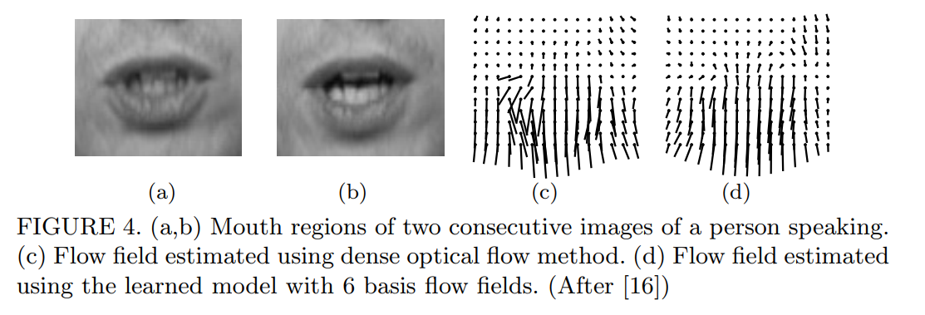
Overview::Paper
Optical Flow
Important Problem : aperture problem
Notes:
https://zh.wikipedia.org/wiki/%E5%85%89%E6%B5%81%E6%B3%95

Slide 32
Overview::Paper
Bag of features
Get feature of image
(SIFT, SURF, etc.)
Use Cluster to build
bag of features
Images
Similar to bag of words

Slide 33
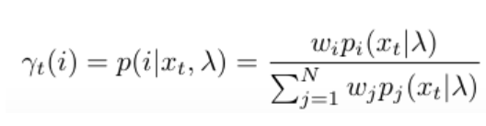
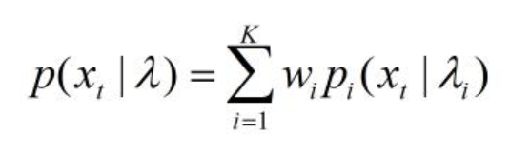
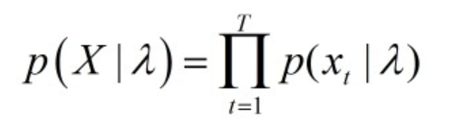
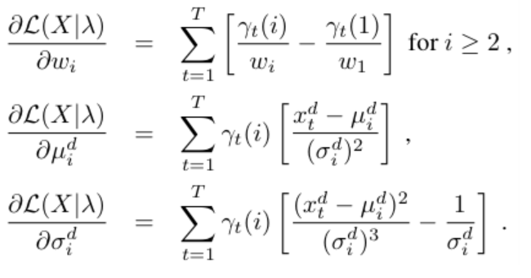
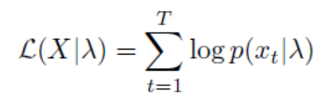
Overview::Paper
FV (Fisher Vector)
Gaussian distribution
partial

Slide 34
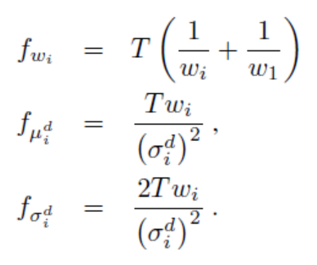
Overview::Paper
FV (Fisher Vector)
Fisher
normalize

Slide 35
Overview::Paper
Some Method of Action Recognition
A typical action recognition flowchart
Direct Classification
Sequential Approaches
Space-time Approaches
Part-based Approaches
Manifold Learning Approaches
Mid-Level Feature Approaches
action representation
action
classification
input
output

Slide 36
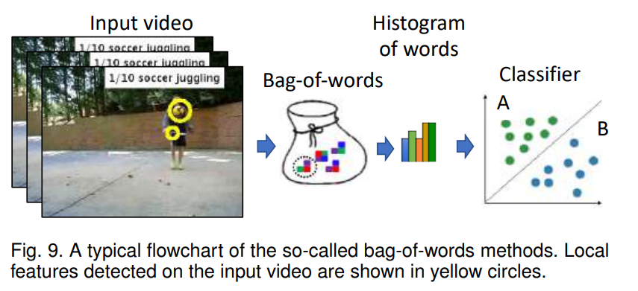
Overview::Paper
typical action recognition
- action classification
Direct Classification:
Use SVM, KNN, etc. as Classifier
Bag of words

Slide 37

Overview::Paper
typical action recognition
- action classification
Sequential Approaches:
Using sequential state models, Ex. hidden Markov models (HMMs), conditional random fields (CRFs), structured support vector machine (SSVM), etc.
Space-time Approaches: Described by a Directional Pyramid Co-occurrence Matrix (DPCM) or Graph. (this method limited to small datasets)
HMMs Source: wiki

Slide 38

Overview::Paper
CRFs

Slide 39


Overview::Paper
typical action recognition
- action classification
Part-based Approaches:
Base on “A Hierarchical Model of Shape and Appearance for Human Action Classification” Juan Carlos Niebles, Li Fei-Fei. CVPR2007
Generally speaking, there are three popular types of features:
1. Static features based on edges and limb shapes
2. Dynamic features based on optical flows
3. Spatialtemporal features that characterizes a space-time volume of
the data

Slide 40
Overview::Paper
typical action recognition
- action classification
Manifold Learning Approaches:
* heavily rely on clean human silhouettes.
Get human silhouettes
PCA
Build CRF

Slide 41


Overview::Paper
typical action recognition
- action classification
Mid-Level Feature Approaches:(link)

Slide 42

Overview::Paper
typical action recognition
- action classification
Mid-Level Feature Approaches: (link)

Slide 43
Overview::Paper
Some Method of Action Recognition
Space-time Networks
Multi-Stream Networks
Hybrid Networks
deep networks
deep learning model
input
output

Slide 44



Overview::Paper
Deep Architecture
0. 2DConv and 3DConv On Video

Slide 45

Overview::Paper
Deep Architecture
Space-time Networks :
ex. “3D Convolutional Neural Networks for Human Action Recognition”

Slide 46

Overview::Paper
Deep Architecture
2. Multi-Stream Networks :
ex. “Two-Stream Convolutional Networks for Action Recognition in Videos”
V2, 2014

Slide 47


Overview::Paper
Deep Architecture
3. Hybrid Networks: (1) LRCN
“Long-term recurrent convolutional networks for visual recognition and description” J. Donahue et al., in CVPR, 2015.

Slide 48

Overview::Paper
Deep Architecture
3. Hybrid Networks: (1) LRCN

Slide 49


Overview::Paper
Deep Architecture
3. Hybrid Networks: (1) LRCN

Slide 50


Overview::Paper
Deep Architecture
3. Hybrid Networks: (1)LRCN

Slide 51

Overview::Paper
Deep Architecture
Hybrid Networks: (2)LTC
“Long-term temporal convolutions for action recognition.”, Gül Varol et al., CoRR, abs/1604.04494, 2016.

Slide 52


Overview::Paper
Deep Architecture
Hybrid Networks: (2)LTC

Slide 53
Overview::Paper
Deep Architecture
Hybrid Networks: (3)KVMF
“A key volume mining deep framework for action recognition.” W. Zhu et al., In CVPR, 2016.

Slide 54

Overview::Paper
Deep Architecture
Hybrid Networks: (4)TSN
“Temporal segment networks: Towards good practices for deep action recognition.”, Limin Wang et al., In ECCV, 2016.

Slide 55

Overview::Paper
Deep Architecture
Hybrid Networks: (4)TSN

Slide 56

Overview::Paper
Deep Architecture
Hybrid Networks: (5)ActionVLAD
“ActionVLAD: Learning spatio-temporal aggregation for action classification”, Rohit Girdhar et al., In CVPR 2017

Slide 57

Overview::Paper
Deep Architecture
Hybrid Networks:(5)ActionVLAD

Slide 58

Overview::Paper
Deep Architecture
Hybrid Networks:(5)ActionVLAD
Different pooling strategies for a collection of diverse features.

Slide 59

Overview::Paper
Deep Architecture
Hybrid Networks:(5)ActionVLAD

Slide 60

Overview::Paper
Deep Architecture
Hybrid Networks:(5)ActionVLAD
Visualization of “action words”

Slide 61


Overview::Paper
VLAD (vector of locally aggregated descriptors)
1.
Get features
2.
Training codebook(k-means)
3.
VLAD encode
4.
normalize
5.
PCA
Dimensionality reduction
ex. use SIFTF features

Slide 62

Overview::Paper

Slide 63
Overview::Paper
2.
Action Prediction
Understanding

Slide 64
Overview::Paper
Two type of prediction
Action Prediction
Motion Trajectory Prediction

Slide 65
Part1.
Action Recognition Research
Section2.
Papers Understanding

Slide 66
PointNet: Deep Learning on Point Sets for 3D Classification and Segmentation
- Charles R. Qi et al., CVPR2017

Slide 67
Graph Attention Networks
- Petar Veličković et al., ICLR2018

Slide 68
Graph Neural Networks: A Review of Methods and Applications
- Jie Zhou et al. 2016

Slide 69
Semi-Supervised Classification with Graph Convolutional Networks
- Thomas N. Kipf, Max Welling, ICLR2017

Slide 70
PiGraphs: Learning Interaction Snapshots from Observations Manolis Savva et al,. SIGGRAPH 2017

Slide 71
NTU RGB+D: A Large Scale Dataset for 3D Human Activity Analysis
- Amir Shahroudy et al., CVPR2016.

Slide 72
Structural Recurrent Neural Network (SRNN) for Group Activity Analysis
- Sovan Biswas, Juergen Gall, WACV 2018

Slide 73


Slide 74
Neural Graph Matching Networks for Fewshot 3D Action Recognition
- M. Guo et al., ECCV2018.

Slide 75



NGM (Neural Graph Matching Networks) structure
NGM

Slide 76


NGM

Slide 77

NGM

Slide 78



NGM
1.
2.

Slide 79

NGM

Slide 80





NGM

Slide 81


NGM

Slide 82

NGM

Slide 83
Unsupervised Learning of Human Action Categories Using
Spatial-Temporal Words
- Juan Carlos Niebles et al., IJCV2008

Slide 84
Discovering Motion Primitives for Unsupervised
Grouping and One-shot Learning of Human
Actions, Gestures, and Expressions
- Yang Yang et al., IEEE TPAMI, 35(7), 2013.

Slide 85
Unsupervised Spectral Dual Assignment Clustering of Human
Actions in Context
- Simon Jones et al., CVPR2014.

Slide 86
Part2.
Datasets Introduction

Slide 87
Part2.
Datasets Introduction
Section1.
Overview of Datasets

Slide 88
overview
Datasets list
No | Name
1 | HACs (Human Action Clips and Segments)
2 | CAD-120 (from cornell)
3 | UCF101
4 | HMDB51
5 | KTH

Slide 89

Action Recognition Datasets
1. HACS
http://hacs.csail.mit.edu/

Slide 90
Action Recognition Datasets
1. HACS
Download:
https://github.com/hangzhaomit/HACS-dataset
Content:
1.55M 2-second clips on 504K videos
140K complete segments on 50K videos
200 difference type of action
200 action name save in HACS_label_name.txt

Slide 91

Action Recognition Datasets
2. CAD-120

Slide 92
Action Recognition Datasets
2. CAD-120
Download:
http://pr.cs.cornell.edu/humanactivities/data.php
Content:
120 RGB-D videos of long daily activities
4 subjects: two male, two female, one left-handed
10 high-level activities
10 sub-activity labels
tracked skeletons
labelname

Slide 93

Action Recognition Datasets
3. UCF-101

Slide 94
Action Recognition Datasets
3. UCF101
Download:
https://www.crcv.ucf.edu/data/UCF101.php
Content:
labelname

Slide 95

Action Recognition Datasets
4. HDMB51

Slide 96
Action Recognition Datasets
4. HDMB51
Download:
http://serre-lab.clps.brown.edu/resource/hmdb-a-large-human-motion-database/
Content:
labelname

Slide 97

Action Recognition Datasets
4. KTH

Slide 98
Action Recognition Datasets
4. KTH
Download:
http://www.nada.kth.se/cvap/actions/
Content:
labelname

